Slide 1
Documenting in Scrum: Is there a better way?
Martina Farkašová

Slide 2
The role of a Content Developer

Slide 3
Being part of the Scrum team…

Slide 4
A cloud on the horizon
Not an equal member of the team
90/10 meetings
Tasks missing some details
Doc tasks excluded from the sprint scope
Releasing docs the same day as the feature
Feature-centered docs

Slide 5
It all started as an experiment…
One experimental team
Introducing PDP 2.0
Faster delivery to customers
Assigned product area
Smaller dev teams
Specialist roles

Slide 6
When change is difficult

Slide 7
Before&After: PDP 2.0 in our team
Our Jira backlog and docs requests
REGular meetings
Dedicated office space

Slide 8
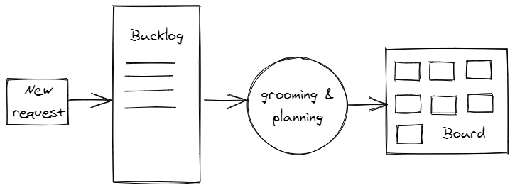
Our own Scrum team
Meetings
Daily, grooming and planning, sync, retrospective
1-week sprints

Slide 9
Prioritizing JIRA tasks
Docs requests vs our own projects
Criteria
Work estimate
Educational impact
User base
Strategy

Slide 10
Long-term benefits
More time on what’s really important
Implementing our own projects
Not wasting time on dev-focused meetings
Scenario-oriented documentation
Devs helping with the feature-related docs

Slide 11
Thank you for your attention!

