Slide 1
Technical Writer’s Workflow
1.0
Levi Valeeva
Technical Writer 2

Slide 2
Creating your first draft
Technical Writer’s Workflow
Gathering information
Doing your own research
Saying the most using the least amount of language

Slide 3
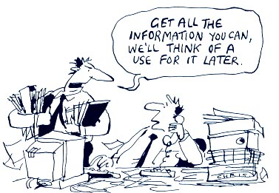
Gathering information
Technical Writer’s Workflow
Your main points of contact:
Project Manager
Content Strategist
Subject Matter Experts (SMEs)
Quality Assurance (QA)

Slide 4
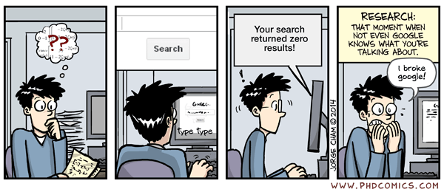
Doing your own research
Technical Writer’s Workflow
Digging deeper:
Audience analysis
Support team
Marketing team
Analytics

Slide 5
Saying the most using the least amount of language
Technical Writer’s Workflow
Things to consider:
What technical documentation should be?
What technical documentation should not be?

Slide 6
What technical documentation should be?
Technical Writer’s Workflow
Correct The most beautifully-written documentation is useless if it is not technically correct.
Clear Even if your documentation is technically correct, users will avoid it if it is not written clearly.
Concise Users have only so much time to go through your documentation. Make it count.
Relevant Stay on topic.

Slide 7
What technical documentation should not be?
Technical Writer’s Workflow
Long Don’t try to educating the reader on everything there is to know about the subject at hand.
Complex Use simple language.
Emotional Emotional language has no place in technical writing.
Anthropomorphic Don’t attribute human traits to non-human entities.

Slide 8
Reviewing your first draft
Technical Writer’s Workflow
SME review
QA review
Peer review

Slide 9
Any questions, comments, concerns?
Technical Writer’s Workflow

Slide 10
Thank you
Red Hat is the world’s leading provider of enterprise open source software solutions. Award-winning support, training, and consulting services make
Red Hat a trusted adviser to the Fortune 500.

