Slide 1

UX driven technical writing
Katka Němcová
TW workshop
5th October 2020

Slide 2

UX driven technical writing
Content of the presentation:
Part 1) UX introduction: a bit of theory cannot hurt anyone.
Part 2) UX designers vs Tech writers: different roles but not that different at all?
Part 3) The best of both worlds: learn, get inspired, integrate!

Slide 3
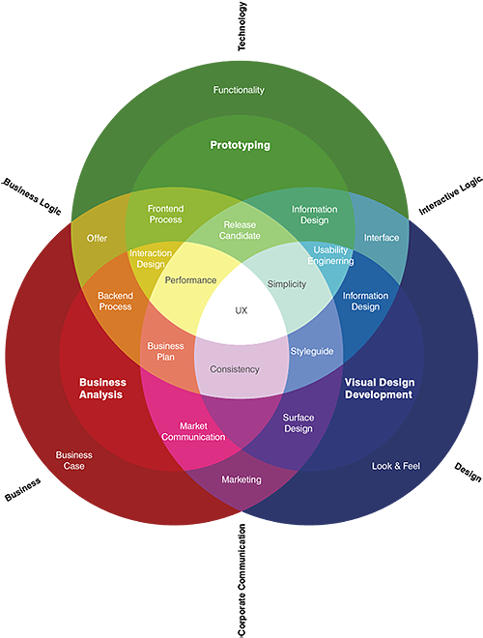


Part 1: UX practices

Slide 4


What is UX?
Effectiveness
Efficiency
Emotional satisfaction
Relationship with the owner of the product
„UX is the totality of end-users‘ perceptions as they interact with a product or services.“
- Kuniavski
UX: How the user feels when they interact with
a system
a product
a service
a website
Part 1

Slide 5

Key UX concepts
Main pillars of the UX strategy:
Interaction Design
Interacion is every action taken by the user while using the product.
Rationale: positive and engaging experience
Information Architecture
Creation of structure of the product, organizing information on where the user is,
and what they need to do to complete their task.
Rationale: clarity
Visual Design
Anything that the user sees while interacting with the product.
Rationale: good first impression, credibility
Functionality
Product must allow the user to complete their desired action.
Rationale: users abandon the malfunctioning process
Usability
The user should not spend any time on figuring out how to use the product.
Rationale: effortless usage of the system
Typography
Rationale: consistent and accessible visual language
User Interface
Content Strategy
Clear, concise, engaging content is best way to deliver meaningful info to the user.
Rationale: helps to build a long-term relationship with the users
Ultimate goal: positive experience
Interaction
Design
Information
Architecture
Visual
Design
Content
Strategy
Functionality
User Interface
Usability
Typography
Usability is essential: a product must first be usable before making it desirable

Slide 6

UX ingredients
5 main ingredients of UX design process:
Psychology: UX is subjective (personal thoughts, emotions)! Subconscious factor.
Usability: product should be easy to use, unambiguous. Conscious factor.
Design: functional, for people who know less than I do.
Copy: should help to achieve the result the shortest and straightest way.
Analysis: ensures objectivity, prevents subjective bias.
Part 1

Slide 7




Part 2: What do they do?

Slide 8
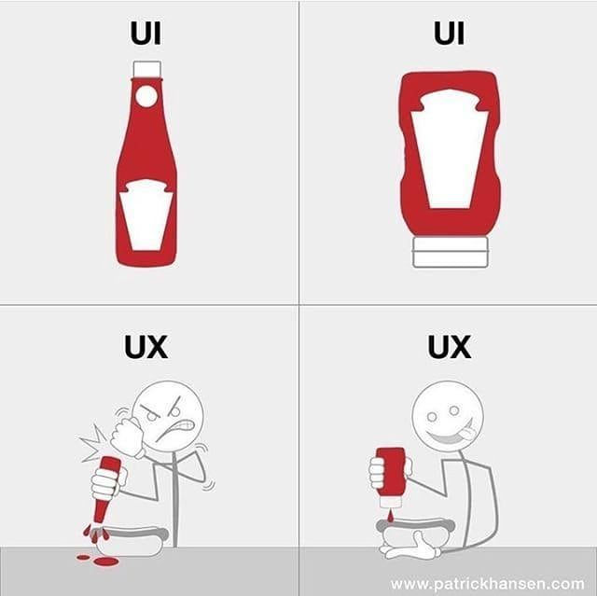
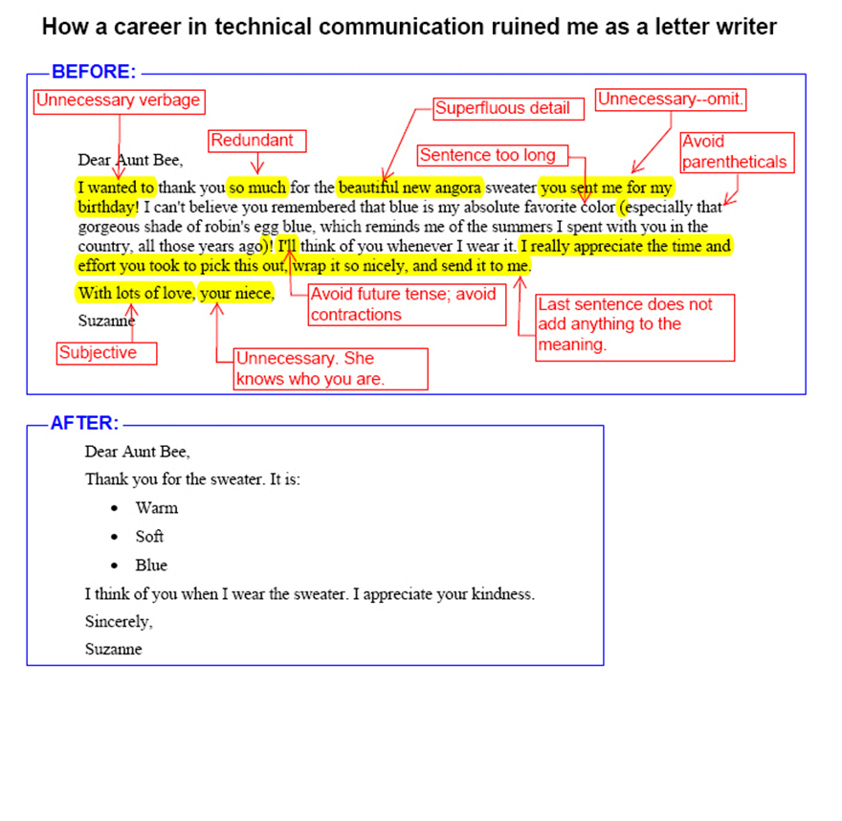



UX designer
vs.
Technical writer
Part 2

Slide 9



UX designer
Technical writer
makes products and technology usable, enjoyable, and accessible for humans.
tends to work as part of a wider product team, often bridging the gap between the user, the development team, and key business stakeholders.
advocates for the end user or customer.
transforms complex and technically difficult input into clear and concise documentation for target audiences.
gathers and develops technical information in order to create maintenance and operating instructions, technical and instructional manuals, journal articles, and other documentation for manufacturers, designers, and clients.
Part 2

Slide 10


Part 3: When the magic happens…

Slide 11





Great design
Purpose + Benefits + Action
Persona + Need + Purpose
User story
What is it?
How will it benefit me?
What action should I take next?
Who is the reader?
What do they want to do?
What do they want to achieve?
Part 3

Slide 12


Usability
Cognitive load:
Amount of invested energy, which is required to finish any single thing that we force the user‘s brain to do.
Example: it takes less effort to read simple words than difficult ones.
Lesson learned for technical writers:
Write the documentation (procedures) such that the user does not have to think how to finish their task.
Part 3

Slide 13

Usability
Usability strategies:
Simplification: less steps required to finish a task.
Disadvantage: some information may be omitted.
Concise steps: detailed description of the individual parts of the procedure.
Disadvantage: more reading for the user, contradicting the
minimalistic effort.
Faster finalization of the task: creating shortcuts.
Disadvantage: it is easier to overlook errors.
Minimalism: to do less better.
Disadvantage: sometimes less is too little for some users.
Mix of the strategies provides the best results!
Part 3

Slide 14

Findability
Hot topic in the information overload on the Internet!
User‘s behavior in the online world:
Browsing: fast scanning (is here something useful for me?)
Search: systematic browsing (I am looking for something specific)
Discovery: finding something interesting by accident (usually the reason why I am always late for bed ☺ )
Lesson learned for technical writers:
Relevance of the described topics and correct usage of the key words are crucial.
Also, smart usage of the Discovery approach: adding hints to discover more (Additional links, resources).
Part 3

Slide 15

Accessibility
The end users come from a broad spectrum of audience in terms of age, culture, health state.
Accessibility is usually considered in connection to visually impaired or color blind people.
Lesson learned for technical writers:
Screen readers for visually impaired people often read in order, which is set in the code, or they can read the content in Tab mode (content selected in the order by pressing the Tab key).
This is something to consider if you want those readers to get to the important parts quickly (relevant content).
For non-native speakers, use simple words.
Always think from the perspective of your audience!
Part 3

Slide 16
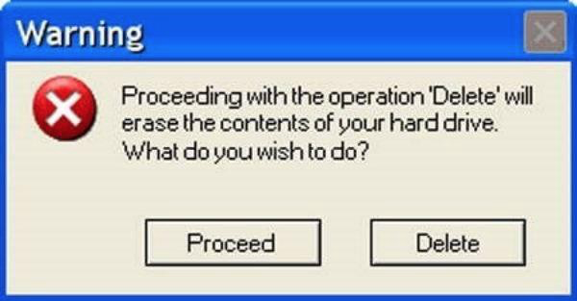
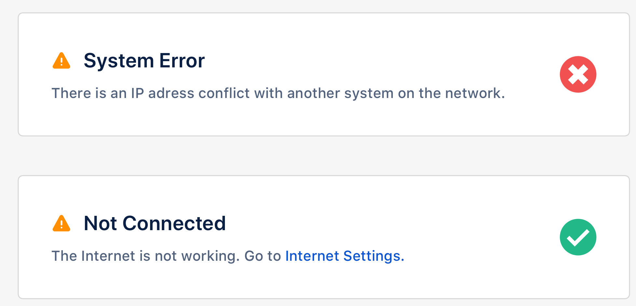
Convinceability
UX writing (copy) is a very specific discipline.
Perfect UX copy is understandable and immediately forgetted when fulfilled its purpose.
The goal is to keep the user interested and make him understand every step he is performing.
Lesson learned for technical writers:
If your project contains any GUI element, error messages, or pop-ups, offer your hand to write or review the UX copy. Your critical thinking and minimalistic skills can be a great asset and will make the end user happy.
Part 3

Slide 17
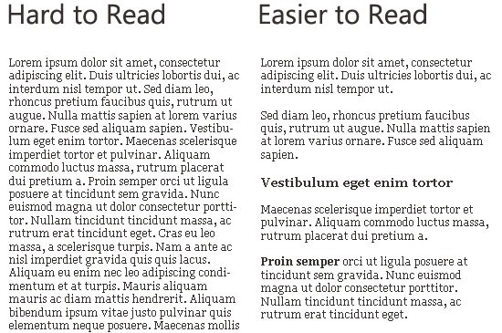
Readability
Readability includes vast world of typography, fonts, font size, formating, and terms like: white space, kerning or leading.
All of them contribute to the user experience of the product significantly.
Lesson learned for technical writers:
If we talk about the websites, product pages or online help pages, usually, a technical writer have only a little influence over this part. However, you can always volunteer to be a beta tester (reader) and provide with a valuable feedback.
As for your own documentation, use text formatting, graphics (where convenient) and strive for a clean text structure.
Part 3

Slide 18

Q+A time

