Slide 1

Writing docs the agile way— Challenges and benefits
October 05, 2020
Shweta Jalgaonkar
Technical Writer at Red Hat

Slide 2
About Shweta
Senior Technical Writer at Red Hat
sjalgaon@redhat.com
Based in Prague, Czech Republic
Agile user since 2010
Specialized in DITA-based authoring, information architecture, and UX writing
Notes:
Hello Everyone,
I am Shweta and I am tuning in from Prague, Czech Republic.
I work with a team of technical writers, content strategists, and various cross-functional teams at Red Hat, for RHEL platform.
I got trained in agile methodologies during my past role at Veritas Technologies, India.
When I was there, agile was implemented across the company and team leads were given trainings to follow and implement agile in their respective teams.
So, ever since then I have had a focus on working with the teams in an agile environment.

Slide 3
The Agenda
1
2
3
4
5
Introduction & Basics
Challenges
Hand in hand with agile
Benefits
Q&A
Notes:
This is the agenda for today.
I would like to start with a short introduction to agile- What is agile, what does it all mean, what are the basics, and then go into the challenges for technical writers and how they can walk hand-in-hand with the agile teams.
We will also see what benefits can agile bring to us as writers, where I would also like to have some recommendations and ideas for the extra work that we as writers can do.
And then we have a Q&A session.
While we progress through this discussion, we will also have some small polls on and off.

Slide 4

Let’s take a poll
Do you have any experience with agile methodologies?
Notes:
Before we start, I would like to take a small poll to figure out how many of us here have any experience to work with agile teams and what everyone already knows about agile.
So, I would like to know how many of you:
Are already working with agile teams
Have you worked with agile teams in the past
Only know about it in theory
Don’t know anything or very little
In the chat, put in a +1 if you are working or have worked with agile teams or -1 if you know about agile only in theory or know very little about it.

Slide 5
Agile-History
Agile alliance formed in 2001
Manifesto
  Individuals and interactions over processes and tools
  Working software over comprehensive documentation
  Customer collaboration over contract negotiation
  Responding to change over following a plan
Notes:
Agile was born in 2001, when a few experts and software developers came together to retrospect their projects.
Earlier to that, projects had defined milestones and everyone would plan at the beginning, then develop everything as per the plan, then test everything that was developed, and then at the end work on various other deliverables.
But it was observed that the project milestones were delayed, project was never in budget, the documentation was not given enough thought, and maybe even the requirements were not fulfilled.
This lead the experts to reconsider the software development cycle to make it more lean and agile.
As a result of this retrospective, the experts published something called as agile manifesto with the core principles that you see here.
The principles emphasize that teams should interact more and should also get involved in customer interactions. It also highlights how important it is for the team to often review the plan, test things, and continuously make the required changes, rather than adhering to a fixed process and plan that might not fit in by the time it takes shape. In a nutshell they realized that the team is at the core of everything and so the focus was more on team interactions rather than the setup.
As they moved ahead, they realized the second point was a big misunderstanding. People assumed that they didn’t really need documentation and the product itself was sufficient for the users. Also, software developers hated to write documentation and did not prefer to set time to pass on the required information to the technical writers.

Slide 6


Agile-Principles
Agile-Methodology and Processes
Incremental development
Develop > Test > Review > Document
Team is the core
Cooperation and communication | Self-organization and ownership
Epics and User stories
As a ……, I want to…..
Sprints
Planning | Scrum meeting | Done-Done-Done | Retrospective
Tracking
Requirements | In progress | In Review | Done | Backlog
Requirements
Notes:
As a result, the agile manifesto has a few principles and a methodology for developing a software.
As part of the incremental development, the requirements that are just in form of high-level asks are broken into logical business use cases (called the epics) and then each of this use case is further broken down into stories and tasks.
Also, rather than first developing everything and then testing, the work is done in smaller time periods called sprints where you do developing, testing, reviewing, and documenting. So, ideally at the end of the sprint, everything that was planned for that sprint should be ready such that it is a functioning software piece that can be shipped to the customer. And then the next cycle starts for the next piece. This way the progress is always measured in terms of functioning software, and at the end, you combine all pieces to deliver a complete piece of software. This way the projects stay in budget and are delivered without much delays.
As for the team, it is something that is important and at the core of agile. The comprises of a mixed group of people from the cross-functional teams like PMs, development, QE, UX, and documentation come together to form a scrum team and they work together to contribute to the progress of the software development. So, everything here is about cooperation and communication in between the team members, and the way they organize themselves to do the work. The important aspect and basis of everything is taking ownership and being responsible for the work that is committed by the team.
The next important thing is the agile methodology where the team builds user stories, assigns them to sprints, and then tracks them. The key factor here is transparency, continuous feedback, and change.
Rather than hiding things, the team needs to be transparent in terms of what’s done, what’s pending, what is in progress and so on. This helps to analyze and plan for the next sprint and how much can be achieved overall.
It not only helps the management to get the status, but also helps the individuals to make a note of how they are placed, what’s on priority, and so on.
Often people prefer tracking Jira tickets or cards on Jira dashboard to keep a track of how things are moving.

Slide 7
Let’s take a poll
How good or bad is your experience with agile?
Notes:
Now that we had a quick overview of agile principles and methodologies, and also know that some of us have experience of working with agile teams, it would be good to share how good or bad is our experience with agile.
Please put in +1 if your experience has been good, and a -1 if it wasn’t a good experience.
Now, if writer’s were asked to stick their challenges on a jam board, how would the jam board look like?

Slide 8
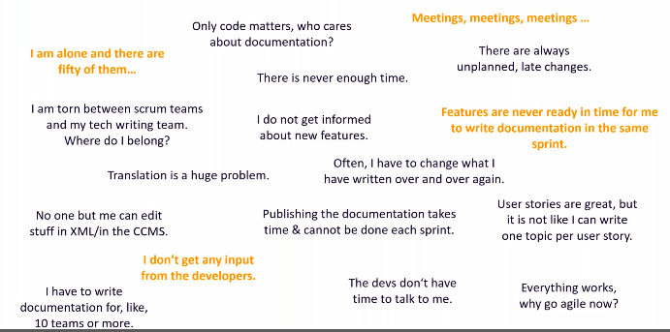
Challenges
Notes:
Does this echo our experiences?

Slide 9
Even more challenges
When to start? — Same sprint | One sprint later | Few sprints later | After the feature is complete
How to write a user story?
Developers are still exploring
Wireframes are still not available
Technical writers have tasks outside of scrum
Notes:
And I am sure writers would like to add a few more

Slide 10
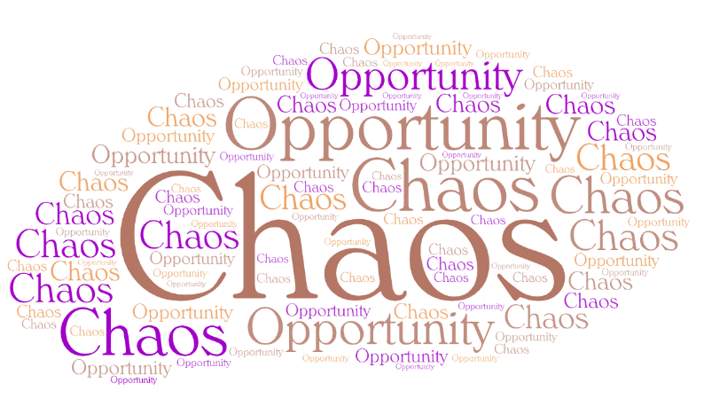
Food for Thought!
In the midst of chaos there is also an opportunity!
-Sun Tzu
Notes:
Yes, most of the challenges that we saw are valid, but there goes a famous quote ‘In the midst of chaos there is also an opportunity!’
So, may be it is worth considering how can we work with the challenges and have better work ways to help get to a common team goal.

Slide 11

How do I exactly beat the challenges?
Notes:
Unsure about how exactly can one beat the challenges?
I think it is a good idea to first have a look at the phases that we have in a project lifecycle. We also know that we have a lifecycle for content development.
In that case, it would be a good idea to see if we can map these two cycles, so that we can work in parallel.

Slide 12
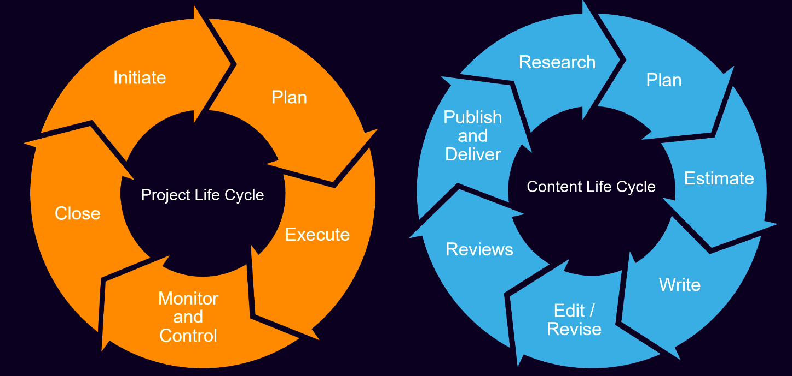
PLC & CLC
Notes:
So, a PLC includes the phases like Initiate > Plan > Execute > Monitor and Control > Close.
During the ‘Initiate’ phase, the PMs bring in the market requirements, review the backlog items, and the teams discuss to list the MVPs, nice to haves, and the to-be deferred candidates.
The Planning phase is mostly an exploration phase where the team discusses the functionalities a bit more in detail to come up with a plan that can be executed to develop the software.
Execution phase is when the developers begin to code, QEs begin to test, and the rest of the contributors begin work at their end as well.
On the same lines, a CLC can have phases like Research > Plan > Estimate > Write > Edit > Review > Publish.
Now, to beat most of the challenges, we need to map the CLC phases with the PLC phases.

Slide 13
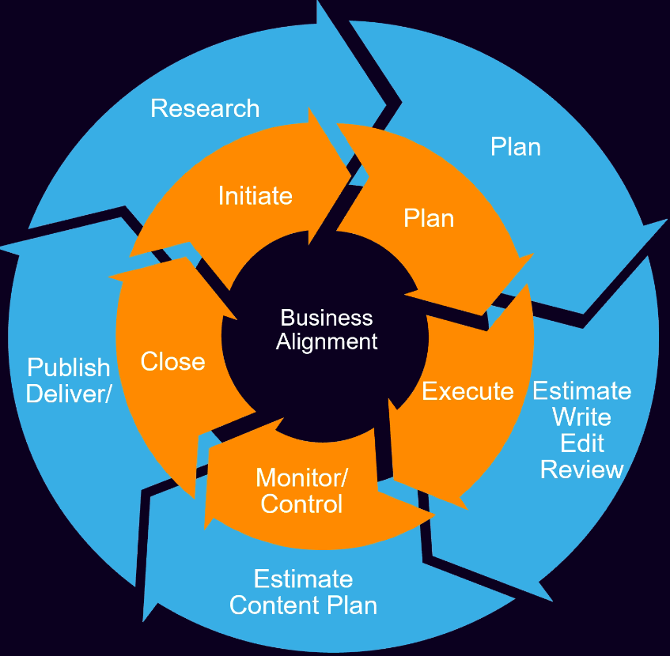
Hand in hand with agile
Notes:
And this is more or less how you can map the phases from the two life cycles.
Now, theoretically it looks great. But one can still be unsure of what exactly can be done as part of these phase to beat the challenges.

Slide 14
Beating the challenges
Input challenges
Participate in planning meetings to know the requirements, functionality, tasks involved and so on, read, research
Initiate
Draft user stories
Identify doc impact
Draft a ToC > Get feedback
Plan
Use scrum meetings for details, feedback, and questions
Schedule interviews with stakeholders (Dev, QE, PM and so on)
Learn in sprint end demos
Test the functionality yourself
Draft content > Get feedback > Implement changes
Execute
Notes:
If you must have noticed, most of the core work seems to be happening in the Initiate, Planning, and Execution phase.
So, let’s focus on these three phases and dig a bit more on what can be done from the doc side to work hand-in-hand with the team.

Slide 15
Beating the challenges
Time challenges
Start in parallel
Review smaller drafts
Add reviewed draft content in CMS
Meeting Challenges
Ideally limit the number of scrum teams that you work with
Prioritize and skip some meetings
Sync up offline
Notes:
In addition to the input challenges, we also saw a few challenges in terms of the time and number of meetings that we are required to attend. How can we beat these challenges?
Well, to address these challenges…………...

Slide 16
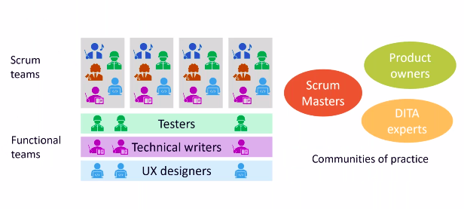
Beating the challenges
Get involved, build rapport, be a team member, take ownership!
Notes:
The key point that would help you beat any challenge is- Get involved, build rapport, be a team member, take ownership!
The more you get involved, the more you get to learn about what’s been worked upon, why, and how. All these factors provide you the required inputs for documenting the piece of work.

Slide 17

Benefits
Notes:
We saw a number of challenges that writers have to deal with. But, on the flip side, there definitely are a few benefits that we can enjoy.
Wonder what?

Slide 18

Benefits
Feel involved and responsible
Understand requirements and business use cases
Fail > learn > improve > fail > learn…….
Apply past learning
Value add
Add skills
Improve content authoring techniques, processes, and tools
Notes:
While it may still feel missed out and not having to speak about many things unlike the dev and QE teams, you definitely have learnt and added a couple of skills.
You definitely have acquired knowledge about the technology, software, market requirements, and so on.
You definitely have built a good rapport with the team members. By now they would be definitely knowing whom to reach out to when they need any doc-side help.

Slide 19

Beyond Technical Writing- Recommendations and ideas
Notes:
But may be adding to something more than just the product documentation is what makes one feel accomplished.
So lastly, I have a few recommendations and ideas about the areas where you can step outside of a writer’s role and contribute to a project.

Slide 20

Beyond Technical Writing- Recommendations and ideas
As communication experts, how about being a scrum master?
As early users, how about stepping up to be a usability tester?
As text experts, how about providing UI reviews and writing UI text?
As early users, how about writing user stories and developing content strategy?
Step up!

Slide 21


Q&A

